Slide 1
Building Microsoft Graph applications
Build a .NET console application using Microsoft Graph

Slide 2

Build a .NET console application using Microsoft Graph
Application registration
NuGet Packages
Application experience
Overview of the sample

Slide 3
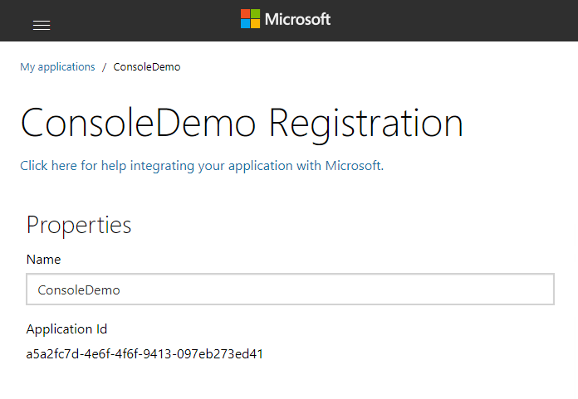
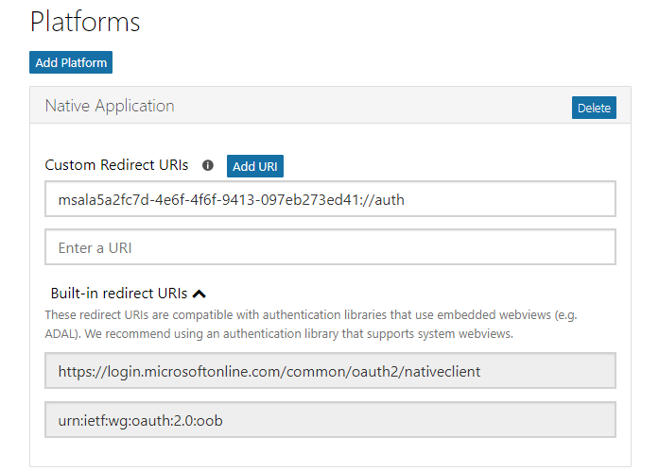
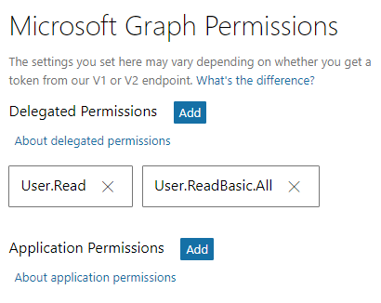
Application registration
Create a new application
Create a new application in the Application Registration Portal. A unique identifier is created for your app.
Add a Native Application platform
Add a Native Application platform to your application registration.
Add permissions
Add permissions that your application will need if your admin will consent for all users.

Slide 4
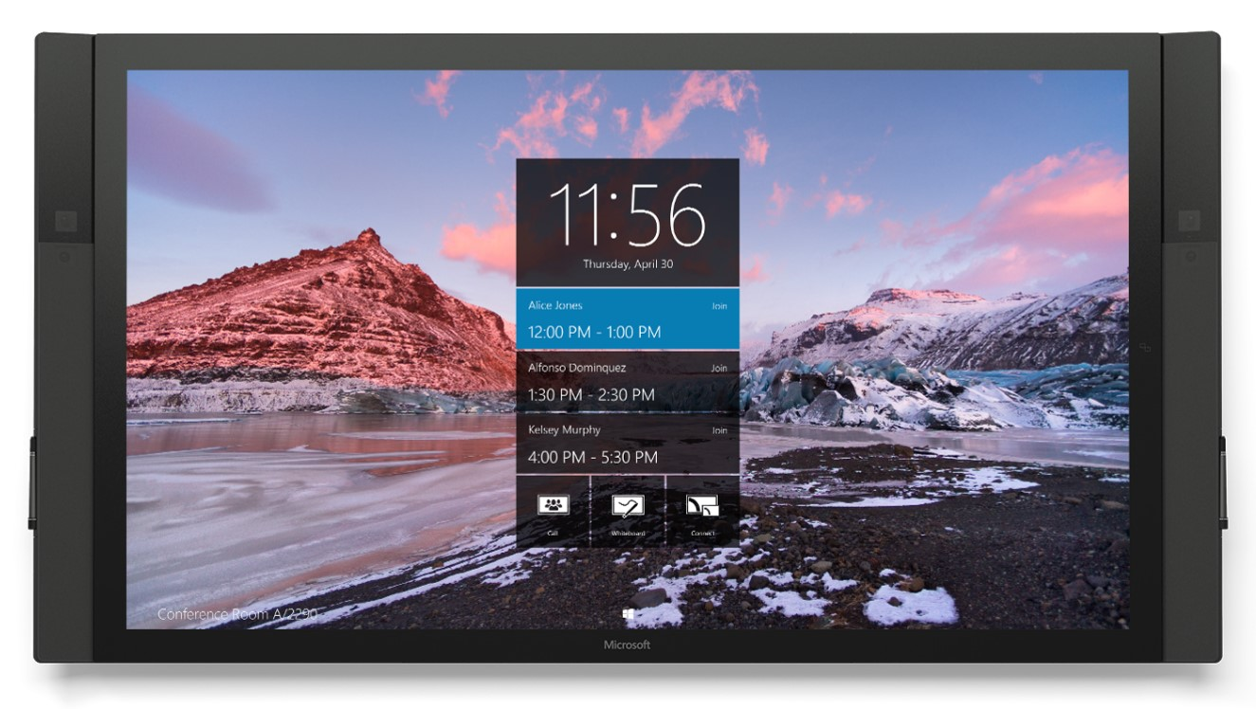
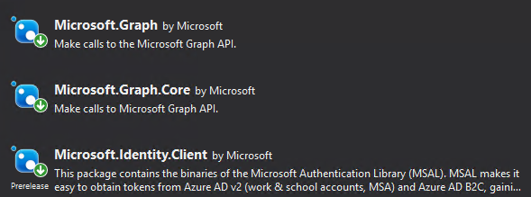
NuGet packages
Notes:
Install-Package “Microsoft.Graph”
Install-Package “Microsoft.Identity.Client” -pre
The Microsoft.Graph.Core package will be installed with Microsoft.Graph as a dependency, as will Newtonsoft.Json.
At the time of this writing, the Microsoft.Identity.Client package is pre-release, make sure to include pre-release packages either using the checkbox in the GUI or including the –pre switch on the command line during preview.
Once the production bits are released, make sure to use the production version.

Slide 5
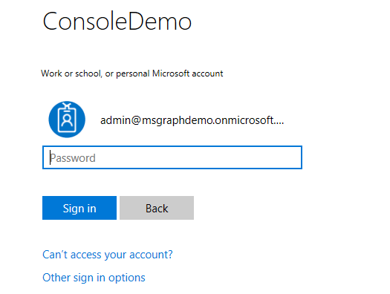
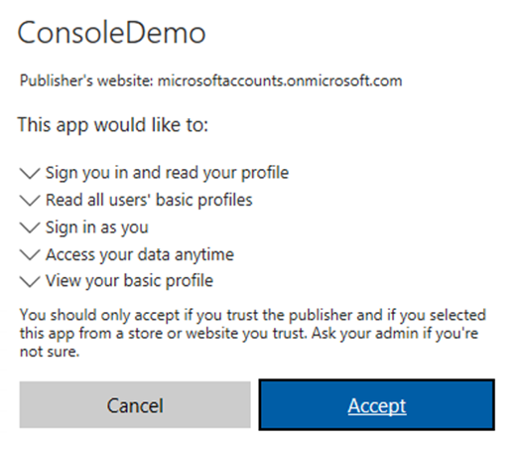
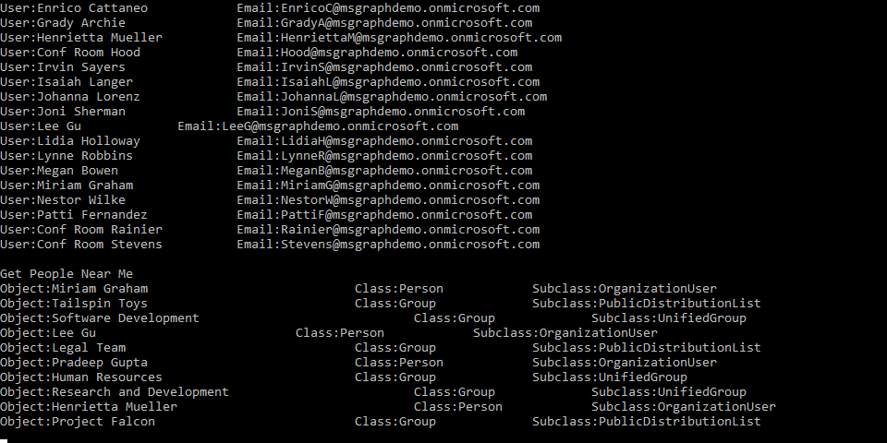
Application experience
User prompted to sign in
The user is prompted to sign in.
Prompt for consent
The user is prompted to grant consent to the application if admin consent was not already granted to the entire tenant.
Data from Microsoft Graph is returned
The Microsoft Graph API is queried and data is returned to the client.

Slide 6


Overview of the sample
https://login.microsoftonline.com/
https://graph.microsoft.com
Sign in, get token
Teams
Groups
Access token
Tasks
Get my profile
Chats
Calendar
Files
My profile
Insights
Microsoft Graph
Messages
Get basic information about all users
Coworkers
User
Meetings
All users’ basic profile
Devices
People

Slide 7
Authorization code grant and v2 endpoint
https://login.microsoftonline.com/common
Application
/common/OAuth/v2.0/authorize
/common/OAuth/v2.0/token
https://graph.microsoft.com
?scope=offline_access+openid+profile+User.Read+User.ReadBasic.All&response_type=code&client_id=…
Sign in, consent
authorization code
?scope=offline_access+openid+profile+User.Read+User.ReadBasic.All&grant_type=authorization_code&code=…
access_token, refresh_token, id_token
/v1.0/me (access token)
Current user’s profile
Token expires
?grant_type=refresh_token&refresh_token=…
access_token, refresh_token, id_token
/v1.0/me (access token)
Current user’s profile
Notes:
Once the access token is acquired, your application continues to call the Graph API without going through the steps to obtain an access token, it just caches it locally and keeps using it. At some point, the token expires. A refresh token is used to obtain a new access token without requiring the user to log in again.
To understand why the MSAL library is important, it’s necessary to understand what it is handling for you. Your code follows a simple pattern to acquire a token silently, and if that fails, acquire a token interactively. Your code does not need to manage the login pop up screen, the interaction for obtaining consent, and does not need to manage token lifetimes.
The call to /common/OAuth/v2.0/authorize will pop up a login screen and request permissions consent.
It is important to cache the refresh token to request a new access token. This is what the MSAL library does for you, there is no action for you as a developer to manage the refresh token. You can create a custom cache for persistence, but MSAL manages the token lifetime.
It is important, however, to understand what the library is doing.

Slide 8
Demo

Slide 9
Scenarios where this is useful
1
Teams
Groups
Enable a user to review and update their profile.
Review all user profiles and verify profile completeness. Send email to users reminding them to update their profile.
Enable a user to view people closely related to them and see what they are working on.
Tasks
2
Chats
Calendar
Files
3
Insights
Microsoft Graph
Messages
And many more…
Coworkers
User
Meetings
People
Devices
Notes:
While this section refers to a very simple scenario, it’s not hard to imagine the new capabilities that you could add to an existing application or new scenarios. Using just JavaScript, you could build an application that gathers intelligence on individuals invited to a meeting such as the files they are working on, the groups they belong to, and people that are common to each of you.

Slide 10
Thank you.

